Slide 1
Cognitive Computing in Support of Human Performance: Applications in Teaching and Learning University of Chicago April 5, 2018
Cornelia Bailey
Frank Greco
Orrin Murray
Orest Xherija
fjgreco@uchicago.edu
fjgreco@us.ibm.com
orrinm@uchicago.edu
Notes:
(Preliminary Remarks)
Calendar time != Project time !=Think Time
“Work In Progress
Invite participation in our project

Slide 2
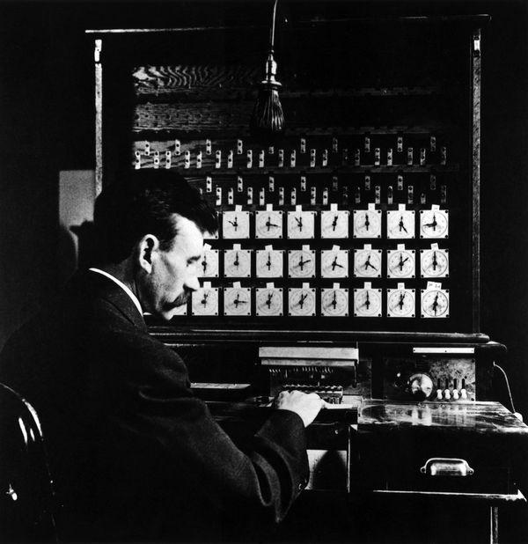
Project Goal
Improve
K-12 Teaching & Learning
Thru
Automation
Classroom
Transcript
Best Practice
Adherence
Assessment
Notes:
(Preliminary Remarks)
Calendar time != Project time !=
Think Time
“Work In Progress
Problems
What makes a good teacher?
How to decipher behavior from discourse?
How to capture/ascertain context/meaning?
Challenges
Limited data
Discourse is messy, nuanced, …
Many unknowns
Why Interesting
Socially relevant
People say its hard to solve
Involves math, linguistics, computation & social, cultural, and human considerations
Discourse Analysis is an active field with room for exploration
History
Herman Hollerith founded the Tabulating Machine Company in 1895. The early TMC machines had 45 columns and used round holes.
When Hollerith's company merged with others to form Computing Tabulating Recording (CTR) in 1911, he received $1.2M for his shares. Hollerith did not get along with Tom Watson, and he left the company soon after Watson arrived.

Slide 3
Data
Curation

Slide 4
Figure 1: Tag Definitions (Excerpt from High Leverage Practices)
FULL_CODE | NAME | DESCRIPTION | FRAMEWORK_AREA | FRAMEWORK_CATEGORY | CORE_PROPOSITIONS
TW01 | Whole class format | The entire class is talking, listening, or working together. Students are not divided into groups or working independently. | High-Leverage Practices | General Teacher Practice | Teachers are responsible for managing and monitoring student learning
TW02 | Small group or partner work | Students are divided into groups or pairs and are working with each other | High-Leverage Practices | General Teacher Practice | Teachers are responsible for managing and monitoring student learning
TW03 | Individual Work | Students are working individually on the same or different tasks. | High-Leverage Practices | General Teacher Practice | Teachers are responsible for managing and monitoring student learning
TW04 | Launching a task or activity | The teacher is beginning an instructional activity or assignment. The teacher might pose a question, explain an assignment, or initiate student work with a text, experiment, or problem. The teacher might set the purpose of the activity or might otherwise motivate and set the context for the work, provide guidelines about how to go about working on it, and get students underway. | High-Leverage Practices | Teaching a lesson or segment of instruction | Teachers are responsible for managing and monitoring student learning

Slide 5
Figure 1: Tag Definitions (Excerpt from High Leverage Practices)
FULL_CODE | NAME | DESCRIPTION | FRAMEWORK_AREA | FRAMEWORK_CATEGORY | CORE_PROPOSITIONS
TW01 | Whole class format | The entire class is talking, listening, or working together. Students are not divided into groups or working independently. | High-Leverage Practices | General Teacher Practice | Teachers are responsible for managing and monitoring student learning
TW02 | Small group or partner work | Students are divided into groups or pairs and are working with each other | High-Leverage Practices | General Teacher Practice | Teachers are responsible for managing and monitoring student learning
TW03 | Individual Work | Students are working individually on the same or different tasks. | High-Leverage Practices | General Teacher Practice | Teachers are responsible for managing and monitoring student learning
TW04 | Launching a task or activity | The teacher is beginning an instructional activity or assignment. The teacher might pose a question, explain an assignment, or initiate student work with a text, experiment, or problem. The teacher might set the purpose of the activity or might otherwise motivate and set the context for the work, provide guidelines about how to go about working on it, and get students underway. | High-Leverage Practices | Teaching a lesson or segment of instruction | Teachers are responsible for managing and monitoring student learning

Slide 6
TW01 | Whole class format | The entire class is talking, listening, or working together. Students are not divided into groups or working independently. | High-Leverage Practices | General Teacher Practice | Teachers are responsible for managing and monitoring student learning

Slide 7
Figure 2: SubRipText (SRT) files
1 00:00:00,000 --> 00:00:04,180 - Okay, I can see two 2 00:00:04,360 --> 00:00:05,090 [inaudible] in here... 3 00:00:05,270 --> 00:00:08,540 - Can you read the article first, please? 4 00:00:08,720 --> 00:00:10,280 - Yes. - Loudly.
Notes:
An SRT file is a subtitle file saved in the SubRip file format. ... SRT files contain subtitle information, which includes the sequential number of subtitles, start and end timecode, subtitle text. The timecode format featured in SRT files is hours, minutes, seconds, and milliseconds ...

Slide 8
Figure 2a: Tag Assignments
CASE_ID,VIDEO_SEGMENT_DATA,IM_SEGMENT_DATA,FRAMEWORK_TAG,RATIONALE,SELECTED_TEXT 1,1_k4pzz8nn:00\:00:14\:04:False,,TW08,ERROR: NO RATIONALE, 1,1_k4pzz8nn:00\:00:15\:00:False,,TW02,ERROR: NO RATIONALE, 1,1_k4pzz8nn:07\:30:08\:05:False,,TW15,The teacher points out useful contributions of two students., 1,1_k4pzz8nn:14\:00:15\:00:False,,TW06,The teacher begins to explain different types of governments (dictatorship is explained in the video)., 1,,,TW08,The teacher reflects on how she could limit her influence on students' decision-making by not providing evaluative comments during the discussion.,"<p>If I had the opportunity to teach this lesson again, I would ask more of the following types of questions: &quot;What would you
...
Notes:
An SRT file is a subtitle file saved in the SubRip file format. ... SRT files contain subtitle information, which includes the sequential number of subtitles, start and end timecode, subtitle text. The timecode format featured in SRT files is hours, minutes, seconds, and milliseconds ...

Slide 9
Figure 2b: Tag Assignments
CASE_ID | VIDEO_SEGMENT_DATA | IM_SEGMENT_DATA | FRAMEWORK_TAG | RATIONALE | USER | SELECTED_TEXT
1 |  |  | TW08 | The teacher reflects on how she could limit her influence on students' decision-making by not providing evaluative comments during the discussion. | ahmedhossain83@gmail.com | <p>If I had the opportunity to teach this lesson again, I would ask more of the following types of questions: &quot;What would you do if...?&quot; and &quot;What do you think about...?&quot; to evoke higher level thinking among students. I would also give more attention and encouraging words to motivate students like Yesenia, knowing that language arts does not appeal to her as much as math does. I would make certain not to influence students&#39; views or push them towards one opinion or another, as in this lesson when Yeimi said, &quot;...The second part of the constitution (she meant article# 75), we should change it. Oh, no we should leave it as it is, as well.&quot; Her hesitation led me to say, &quot;I like the way you compromise&quot;, as my intention was to, indirectly, suggest that she should compromise and go with the change like other group members. If I had to teach this lesson again, I would instead ask, &quot;What do you think?&quot; and leave the decision for the group to make, as I think that my guidance was not productive</p>
1 |  |  | TW24 | The teacher reflects on how she could limit her influence on students' decision-making by not providing evaluative comments during the discussion. | ahmedhossain83@gmail.com | <p>If I had the opportunity to teach this lesson again, I would ask more of the following types of questions: &quot;What would you do if...?&quot; and &quot;What do you think about...?&quot; to evoke higher level thinking among students. I would also give more attention and encouraging words to motivate students like Yesenia, knowing that language arts does not appeal to her as much as math does. I would make certain not to influence students&#39; views or push them towards one opinion or another, as in this lesson when Yeimi said, &quot;...The second part of the constitution (she meant article# 75), we should change it. Oh, no we should leave it as it is, as well.&quot; Her hesitation led me to say, &quot;I like the way you compromise&quot;, as my intention was to, indirectly, suggest that she should compromise and go with the change like other group members. If I had to teach this lesson again, I would instead ask, &quot;What do you think?&quot; and leave the decision for the group to make, as I think that my guidance was not productive</p>
1 | 1_k4pzz8nn:14\:00:15\:00:False |  | TW06 | The teacher begins to explain different types of governments (dictatorship is explained in the video). | ahmedhossain83@gmail.com
1 | 1_k4pzz8nn:07\:30:08\:05:False |  | TW15 | The teacher points out useful contributions of two students. | ahmedhossain83@gmail.com
2 | 1_ctduhs1x:09\:00:11\:10:False |  | TW05 | The teacher moves between groups listening to the mathematical conversations and responding to questions. | ahmedhossain83@gmail.com
2 | 1_ctduhs1x:06\:45:08\:20:False |  | TW13 | The teacher asks a student in a small group a series of questions to check to see her understanding of the components of a problem. | ahmedhossain83@gmail.com
2 | 1_ctduhs1x:05\:20:06\:20:False |  | TW10 | The teacher reviews a mathematical procedure with a single student. | ahmedhossain83@gmail.com
2 | 1_ctduhs1x:04\:20:05\:00:False |  | TW09 | The teacher explains the differences between types of mathematical series to a small group of students during group work. | ahmedhossain83@gmail.com

Slide 10
Tag Labels and Text (Marshalled)
Index, CaseID, Tag List
index:189 doc:tagdoc_1042 content:TW08 TW24TW08
index:190 doc:tagdoc_1046 content:TW01 TW08
index:191 doc:tagdoc_1047 content:TW04 TW08 TW18
index:192 doc:tagdoc_1049 content:TW08
index:193 doc:tagdoc_1053 content:TW16
index:194 doc:tagdoc_1054 content:TW01 TW08
index:195 doc:tagdoc_1057 content:TW06s TW08 TW11
Index,CaseID,Filename 0,118,Copy of 118 GEN MC 118edited.srt.txt 1,014 ,Copy of 014B LMECYA014B.srt.txt 2,285 ,Copy of 285B SCI EA 285 B edited.srt.txt 3,161,Copy of 161 SCI EA 161 edited.srt.txt 4,085 ,Copy of 085A MUSIC EMC 085 A.srt.txt 5,074 ,Copy of 074A ENL EMC 074A edited.srt.txt 6,101,Copy of 101 SSH EA 101 edited.srt.txt 7,079,Copy of 079 MUSIC EMC 079.srt.txt 8,1047,Copy of 1047 SCI AYA 1047edited.srt.txt 9,128,Copy of 128 PE EAYA 128edited.srt.txt 10,244 ,Copy of 244A SCI EA 244 A edited.srt.txt

Slide 11
Figure 3: Example Curated File (Copy of 002 MATH AYA 002 edited.srt.txt)
Transcriber Annotated
Transcriber Annotation Removed
Negative x minus it? (muffled speaking) It's one over, oh wait, oh wait wait wait wait. [Voiceover] How do we solve for X? [Voiceover] X is the value of R anyway. X is the value of R. What would you do for the one over X? Wouldn't that be the first term? [Voiceover] X is the value of R (speech drowned out). What I would suggest you do is, is that you could rewrite this as an expression. Oh, as the power (inaudible)? Oh. Oh, okay okay. I used (inaudible). [Voiceover] Oh, yeah yeah. All right, yeah I got it.
So it's gonna be negative X minus one, okay. Okay, no I got it.
So the first, it's gonna be, so what-- (coughing over talking) [Voiceover] Whatever. (multiple students talking at once) [Voiceover] Oh, come on.
Negative x minus it? It's one over, oh wait, oh wait wait wait wait. How do we solve for X? X is the value of R anyway. X is the value of R. What would you do for the one over X? Wouldn't that be the first term? X is the value of R . What I would suggest you do is, is that you could rewrite this as an expression. Oh, as the power ? Oh. Oh, okay okay. I used . Oh, yeah yeah. All right, yeah I got it. So it's gonna be negative X minus one, okay. Okay, no I got it. So the first, it's gonna be, so what-- Whatever. Oh, come on.

Slide 12
TW01 | Whole class format | The entire class is talking, listening, or working together. Students are not divided into groups or working independently. | High-Leverage Practices | General Teacher Practice | Teachers are responsible for managing and monitoring student learning
SubRip File 1
00:00:00,000 --> 00:00:04,180 - Okay, I can see two 2 00:00:04,360 --> 00:00:05,090 [inaudible] in here...
CASE_ID,VIDEO_SEGMENT_DATA,IM_SEGMENT_DATA,FRAMEWORK_TAG,RATIONALE,SELECTED_TEXT 1,1_k4pzz8nn:00\:00:14\:04:False,,TW08,ERROR: NO RATIONALE, 1,1_k4pzz8nn:00\:00:15\:00:False,,TW02,ERROR: NO RATIONALE
Annotation Vector
[muffled speaking] [ ] [Voiceover] [Voiceover] [ ] [Voiceover,
(speech drowned out). []. (inaudible). (inaudible).
[Voiceover]
(coughing over talking) [
[Voiceover[ [Multiple] [Voiceover]
De-annotated Transcript
Negative x minus it? It's one over, oh wait, oh wait wait wait wait. How do we solve for X? X is the value of R anyway. X is the value of R. What would you do for the one over X?
Wouldn't that be the first term? X is the value of R . What I would suggest you do is, is that you could
rewrite this as an expression. Oh, as the power ? Oh. Oh, okay okay. I used . Oh, yeah yeah. All right, yeah I got it.
So it's gonna be negative X minus one, okay.
Okay, no I got it. So the first, it's gonna be, so what-- Whatever. Oh, come on.
Index, CaseID, Tag List
i189, 1042 [TW08 TW24TW08]
index:190 doc:tagdoc_1046 content:TW01 TW08
index:191 doc:tagdoc_1047 content:TW04 TW08 TW18
Index,CaseID,Filename 0,118,Copy of 118 GEN MC 118edited.srt.txt
1,014 ,Copy of 014B LMECYA014B.srt.txt 2,285 ,Copy of 285B SCI EA 285 B edited.srt.txt

Slide 13
(muffled speaking) [ ] [Voiceover] [Voiceover] [ ] [Voiceover,
(speech drowned out). []. (inaudible (inaudible). [Voiceover]
[]
(coughing over talking) [Voiceover]
(multiple students talking at once) [Voiceover]

Slide 14
Curation: Feature Extraction
NLC
Topic Drift
Sentences
Entities
Sentiment
Topics
-Language identification
.srt annotations
e.g., [teacher],[class],[mumbling]
Relations
-Stop Words
POS (questions, imperatives, etc.)
n-grams
Custom Python
Join segments
SRT
Feature
Extraction
&filtering
NLU
SKlearn
StanfordCore
text_dict
Tag Datasheet
tag_dict
tag pair frequencies
ffmpeg
WSTT
Video
Audio
Speaker Differentiation
Notes:
May be include this farther down?

Slide 15
Challenges

Slide 16
Data Challenges
Limited (training) set size
Noisy; discourse is messy
Inconsistent lengths
No “bad” practice examples
Does sufficient information exist in the audio transcripts to ascertain best practice behavior?
Can such information be extracted as features useful to a machine learning model?
What would such a model be, and can it be efficiently calculated?
What are the unknowns?
Do we sufficiently understand the problem?
What are the adjacent fields of Inquiry?
What information and methods are useful?
Notes:
The realization did not come immediately
Skepticism
Can attempt to handle with cross verification

Slide 17
“Boundary” Challenge…
Ill-defined Domain Boundaries
(and intra-dialogue)
Geographic Region
Grade level
Well-define Domain Boundaries
e.g., Customer Service,
Campaign Issues
Socio-ethnic backdrop
Evaluator’s Experience*
Temporal
e.g., Day 1, Start of class, ,mid-term?
Tennis ~
Badminton, Ping Pong, Volleyball...Handball
Um, "Injustice anywhere is a threat to justice everywhere."
“He said.. She said” vs whatever the underlying topic of discussion may be about.
…suggests we might need to incorporate features from outside the transcripts , manually annotate
a training corpus, or get more data.
Notes:
We new from the outset that in principle context would be an issue.

Slide 18
Figure 4: Project Organization: Iterative Inquiry Process
Curation
Idea
Idealism
Vectorize
Supervised
Classification
Heuristic
Checks
Unsupervised categorization/clustering
Insight
Visualization &
Reporting
Interpretation
Realism

Slide 19
Combinatorial Challenges
SUPERVISED
Classification & Regression
Logistic Regression
Neural Networks
Random Forest
SVM
Adaboost
Labeled - LDA
Naïve-Bayes
…
SEMI-SUPERVISED
~Maximum Entropy
…
UNSUPERVISED
Clustering & Associations
K-means
PCA
LDA
…
Full Corpus
Transcripts
Utterances
Hyper- Parameters_{method}
Sentences
Words
...
Notes:
Linguistic Context

Slide 20
Project Organization & Approach
Dialogue:
Gain insight into the problem and prioritize
our activities
The importance of context, classroom behavior vs topic analysis
Meaning is established in a social context
Computational Experiments/Inquiries:
Data Curation
Feature extraction
Analytic/ML Tool development/application
Reading Outside Research:
Discourse Analysis
Machine Learning Methods
Applicability Recurrent and LSTM neural network technology
Notes:
We knew that there was much we did not know; we knew this was a hard problem.
R&R came later.

Slide 21
Experiments & Inquiries
Visualization
Notes:
Heat Map; graphs; LDA & Cosine Similarity

Slide 22
Primary Focus Areas
Tag – Transcript Relationships
Transcript Analysis
Clustering
Categorization
Feature Extraction
Tag Analysis
Clustering in assignments
Correlation in meaning

Slide 23
Heuristic Insight
ευρετική
Notes:
Heuristic algorithms often times used to solve NP-complete problems, a class of decision problems.

Slide 24
Term Frequency – Inverse Document Frequency Matrix TF-IDF
 | D1 | D2 | D3 | D4 |  | IDF Factor
This | .25 (.576) | .25 (.576) | 0 | 0 | 2 | 2.303
is | .25 (.474) | .25 (.474) | 0 | .125 (.237) | 3 | 1.897
a | .25 (.347) | .25 (.347) | 0 | .375 (.520) | 5 | 1.386
fight | 0 | 0 | .25 (.749) | 0 | 1 | 2.996
cat | 0 | .25 (.402) | .25 (.402) | .25 (.402) | 4 | 1.609
dog | .25 (.474) | 0 | .25 (.474) | .135 (.256) | 3 | 1.897
not | 0 | 0 | 0 | .125 (.375) | 1 | 2.996
and | 0 | 0 | .25 (.749) | 0 | 1 | 2.996
 | 4 | 4 | 4 | 8 | 20
D1: This is a dog.
D2: This is a cat
D3: Cat[s] and dogs[s] fight.
D4. A cat is a cat, not a dog.
TF(t) = (Number of times term t appears in a document) / (Total number of terms in the document).
IDF(t) = ln(Total number of documents / Number of documents with term t in it).

Slide 25
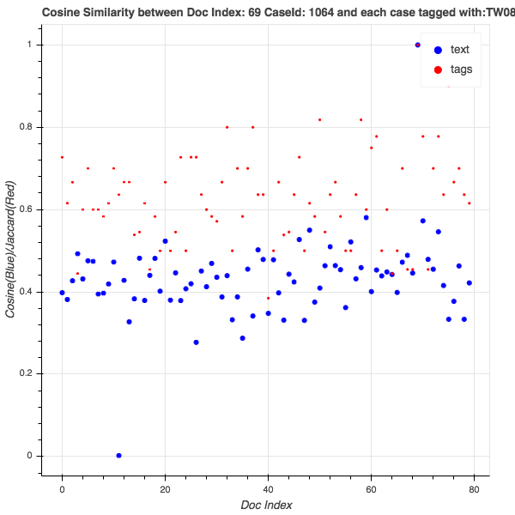
Figure 5: Similarity Check Example using Cosine Metric and Jaccard Index
TF(t) = (Number of times term t appears in a document) / (Total number of terms in the document).
IDF(t) = log_e(Total number of documents / Number of documents with term t in it).
TF-IDF matrix ::
TF-IDF_{document, term}
Cosine Similarity: Inner product of document vectors from
the TF-IDF matrix
Jaccard Index: Intersection of Tag Sets / Union of Tag Sets
Notes:
TF(t) = (Number of times term t appears in a document) / (Total number of terms in the document).
IDF(t) = log_e(Total number of documents / Number of documents with term t in it).
There are other potential scaling factors besides IDF

Slide 26
Figure 7: Statistical Summary From TW04 Run
Notes:
Pearson Correlation
Pearson's correlation coefficient is the covariance of the two variables divided by the product of their standard deviations. The form of the definition involves a "product moment", that is, the mean (the first moment about the origin) of the product of the mean-adjusted random variables; hence the modifier product-moment in the name.
The Spearman correlation between two variables is equal to the Pearson correlation between the rank values of those two variables; while Pearson's correlation assesses linear relationships, Spearman's correlation assesses monotonic relationships (whether linear or not). If there are no repeated data values, a perfect Spearman correlation of +1 or −1 occurs when each of the variables is a perfect monotone function of the other
A small p-value (typically ≤ 0.05) indicates strong evidence against the null hypothesis, so you reject the null hypothesis. A large p-value (> 0.05) indicates weak evidence against the null hypothesis, so you fail to reject the null hypothesis.

Slide 27
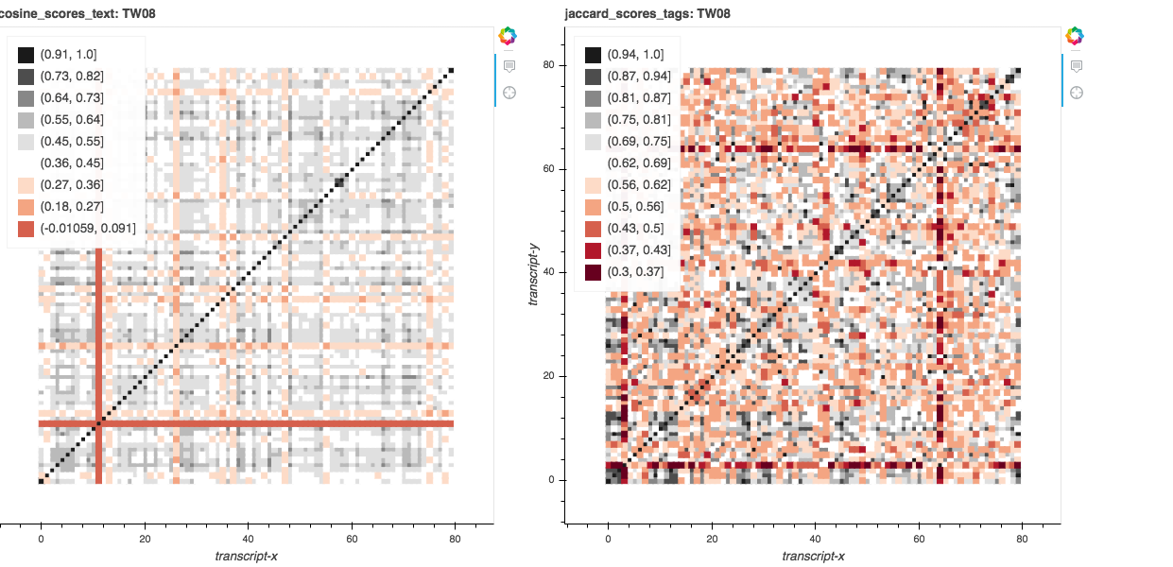
Figure 6: Filtered Corpus: Documents that include TW08 as a label

Slide 28
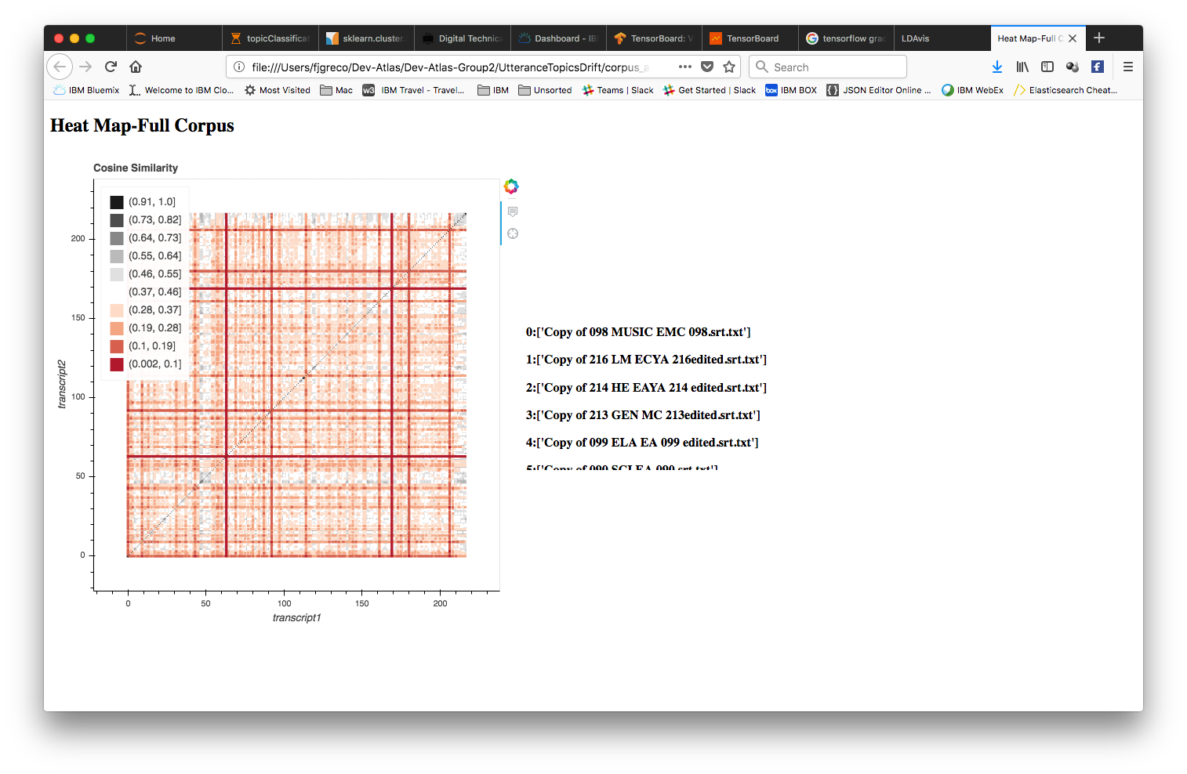
Figure 8: Full Corpus Transcript to Transcript Cosine Similarity View
Link to Page
Notes:
# # Plot heatmap of cosine similarities between all pairs of transcripts. #
Also looked at tag pairings, n-gram analysis, and LDA/ a variety of k-means analysis of n-grams.

Slide 29
Technical - Digression
TF-IDF
We can look at cosine similarities of documents or terms
Dimensionality Reduction
Singular Value Decomposition
Word embedding
LSI captures latent semantics (conceptual relationships), but has limitations
The concept may apply, however, if we can get the right encoding of discourse
and relate it to behavior.
Classification and Categorization
K Nearest Neighbor Clustering
K Means Classification
...

Slide 30
Lay Person Assessment
Human Intervention

Slide 31
Experiment #7 – Manual Tagging
Instructions and Transcripts given to Independent Reviewers:
Decide which tags you will assign to each .txt. Of course a given .txt can have multiple tags.
For each tag you assign to a given .txt, I want you make a list of features (quantifiable features) that led you to assign the particular tag. For example, suppose that I assign tag TW01 to the first .txt. One potential quantifiable feature that might explain that tag is the high number of speakers in the transcript. Say, there are 5 different people speaking, so that leads me to assign TW01 about whole class format. My example is random and this might not apply to TW01 per se, but I hope that it illustrates the point about quantifiable features.
Copy of 009 LRLAEMC009.txt (not tagged withTW07)
Copy of 027 ELAAYA027.txt (not tagged with TW07)
Copy of 053 GEN EC 053 edited.txt (Tagged with TW07)
Copy of 129 LRLA EMC 129edited.txt (Tagged with TW07)

Slide 32
Feedback From Reviewers
Both reviewers assigned tags at the phrase level as well as sentence, utterance and document levels.
Both reviewers acknowledged a degree of confirmation bias
Both reviewers came up with different, though not disjoint, tag assignment from each other and from the those of the Atlas reviewers.
4. The teaching professional’s background experience played a significant role in her recognizing behavioral patterns.
Copy of 027 ELAAYA027.txt (tw12, 13, 22).docx
Copy of 053 GEN EC 053 edited.txt (tw13,17,19,21).docx
NinaRyanTagging transcripts.pdf

Slide 33
Analytic Examples

Slide 34
Figure 9: Experiment #8 – Tag Assignment using Latent Semantic Indexing & pseudo-K-means
Transcript Corpus
LSI Similarity Model
Match Probabilities
Tag (label) Associations
Tag Frequencies
Candidate Tag Assignment
Test Document
LSI Representation
Notes:
LSI captures latent semantics (conceptual relationships), but has limitations
The concept may apply, however, if we can get the right encoding of discourse
and relate it to behavior.

Slide 35
Tag Assignment Using Latent Semantic Indexing
Target Document:
('825', 'Copy of 825 SCI EA 825 edited.srt.txt', 0.9999714)
[u'TW01', u'TW02', u'TW08', u'TW13', u'TW17', u'TW22', u'TW23', u'TW24’]
Output Excerpt:
('122 ', 'Copy of 122B CTE EAYA 122 B edited.srt.txt', 0.99997085) [u'TW02', u'TW06', u'TW07', u'TW13’]
('167', 'Copy of 167 PE EMC 167 edited.srt.txt', 0.999532) [u'TW01', u'TW02', u'TW03', u'TW04', u'TW05', u'TW06', u'TW11', u'TW13', u'TW17', u'TW18', u'TW24TW17’]
('1031', 'Copy of 1031 SCI AYA 1031edited.srt.txt', 0.9992397) [u'TW09s’]
Candidate Tags
(u'TW01', 7)
(u'TW02', 6)
(u'TW05', 5)
(u'TW17', 4)
(u'TW09s', 3)
(u'TW08', 3)
(u'TW13', 3)
(u'TW06', 2)
(u'TW04', 2)
(u'TW03', 2)
Notes:
Consider the similarity of one tag to other tags.
Need domain/ expert/ lay person evaluation.
<Bring up Jupyter Notebook>

Slide 36
K-Nearest Neighbor Results Example>
# retained documents: 217
vectorize
Tag: TW04, Count: 217
Tag: TW12, Count: 217
multilabel.shape: (217, 2)
Tags: ['TW04', 'TW12']
Run:0
Run:1
Run:2
Run:3
Run:4
Total Test Successes: 76 Total Test Failures: 9
test_success_ratio: 0.894117647059
Total Train Successes: 889 Total Train Failures: 111
train_success_ratio: 0.889

Slide 37
Technical - Digression
TF-IDF
We can look at cosine similarities of documents or terms
Dimensionality Reduction
Singular Value Decomposition
Word embedding
Classification and Categorization
K Nearest Neighbor Clustering
K Means Classification
...

Slide 38
Singular Value Decomposition
Singular value decomposition takes a rectangular matrix of e.g. TF-IDF (defined as M, where M is a n x p matrix) in which the n rows represents the word, and the p columns represents the documents. The SVD theorem states:
M_{nxp}= U_{nxn} S_{nxp} V^{T}_{pxp}
Where
U^{T}U = I_{nxn}
V^{T}V = I_{pxp} (i.e. U and V are orthogonal)
Where the columns of U are the left singular vectors (word coefficient vectors); S (the same dimensions as M) has singular values and is diagonal (mode amplitudes); and V^{T} has rows that are the right singular vectors (document level vectors). The SVD represents an expansion of the original data in a coordinate system where the covariance matrix is diagonal
Dimensionality Reduction
M_{k}= U_{k} S_{nk} V^{T}_{k}
Notes:
Ax = Lambda x – eigenvector x and eigenvalue
Au = sigma v - singular value and singular vectors u and v
A^{H}v = sigma u
Hermitian Transpose is complex conjugate transpose of a complex matrix.
If A is real then A^{T} = A^{H}
The singular values of a m×n matrix A are the square roots of the eigenvalues of the n×n matrix X^{H} X

Slide 39
SVD Application
Compare documents: S_{k} d₁ ~ S_{k} d₂
Compare terms: S_{k} t_{1,} ~ S_{k} t₂
Cluster terms and documents e., k-means
Categorize a document by rendering it in the lower dimensional space and then compare it to
a documents in the corpus:
d₁ = S⁻¹U ^{T}_{k} d₁

Slide 40
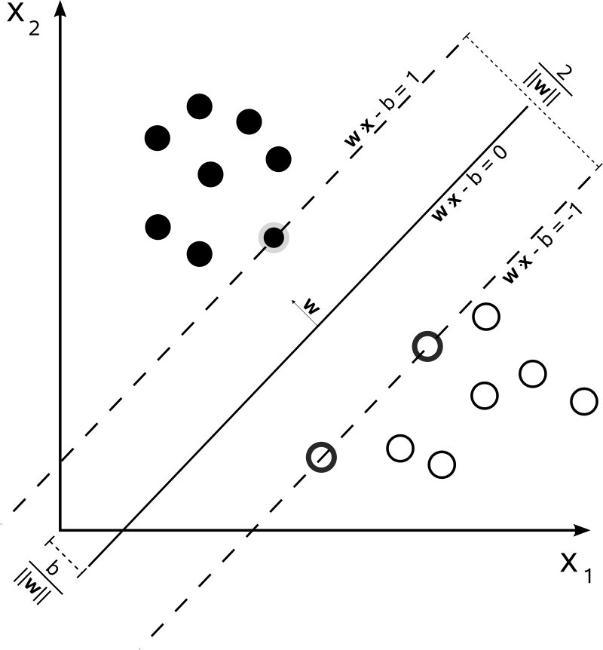
Linear SVM (Intuitive View)
Given a set of training dataset of data points e.g:
(x₁,y₁), (x₂,y₂), ... (x_{n},y_{n}) where y_{i} is 1 or -1
We seek a line (hyperplane) that divides the
set into two groups.
If the data in linearly separable we can find
a margin around the line..
Image Source: Wikipedia

Slide 41
Linear SVC (Support Vector Classification) – Excerpt
Tag: | #With Tag | #Without Tag | #With/Total Ratio | Testing Set Size | Training Set Size | Accuracy
TW01 | 114 | 103 | 0.525345622 | 21 | 196 | 0.571428571
TW02 | 129 | 88 | 0.594470046 | 21 | 196 | 0.428571429
TW03 | 19 | 198 | 0.087557604 | 21 | 196 | 0.904761905
TW04 | 23 | 194 | 0.105990783 | 21 | 196 | 0.952380952
TW05 | 69 | 148 | 0.31797235 | 21 | 196 | 0.714285714
TW06 | 46 | 171 | 0.211981567 | 21 | 196 | 0.761904762
TW07 | 24 | 193 | 0.110599078 | 21 | 196 | 0.714285714
TW08 | 79 | 138 | 0.3640553 | 21 | 196 | 0.80952381
Notes:
Binary classifier using linear SVM

Slide 42
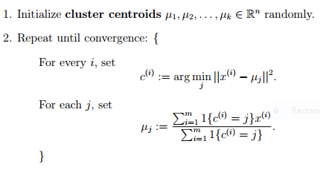
K-Means Clustering
Given training points x₁,x₂, ... x_{n} find a set of centroids that represent a set of k clusters:
Image source: Stanford CS221 class notes

Slide 43
K - Nearest Neighbor Classification
Given a set of training dataset of data points e.g:
(x₁,y₁), (x₂,y₂), ... (x_{n},y_{n})
and given a target feature vector X,
find the K nearest neighbors, and assign the majority class (y).

Slide 44
Inquiry 1 - Speech Act Identification
Notes:
Questions → Stanford Core NLP POS parser
Imperatives → Parse tree → Verb position & type
Declarative → Parse tree →?
Interjection → e.g. Uh-uh, Mm-mm, Okay, (NLC classifier?)
Semantic Role → if NER is the subject actor, NER not likely to be a student

Slide 45
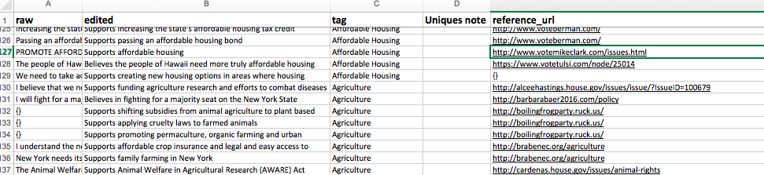
Topic Oriented Labeling vs Speech Act Annotation (Input from Ballot Ready)

Slide 46
Topic Labeling vs Speech Act Annotation
Fragment of a labeled conversation (from the Switchboard corpus).
Speaker | Dialogue Act | Utterance
A | YESNOQUESTION | So do you go to college right now?
A | ABANDONED | Are yo,
B | YESANSWER | Yeah,
B | STATEMENT | it’s my last year [laughter].
A | DECLARATIVEQUESTION | You’re a, so you’re a senior now.
B | YESANSWER | Yeah,
B | STATEMENT | I’m working on my projects trying to graduate [laughter].
A | APPRECIATION | Oh, good for you.
B | B BACKCHANNEL | Yeah.
A | APPRECIATION | That’s great,
A | YESNOQUESTION | um, is, is N C University is that, uh, State,
B | STATEMENT | N C State.
A | SIGNALNONUNDERSTANDING | What did you say?
B | STATEMENT | N C State.

Slide 47
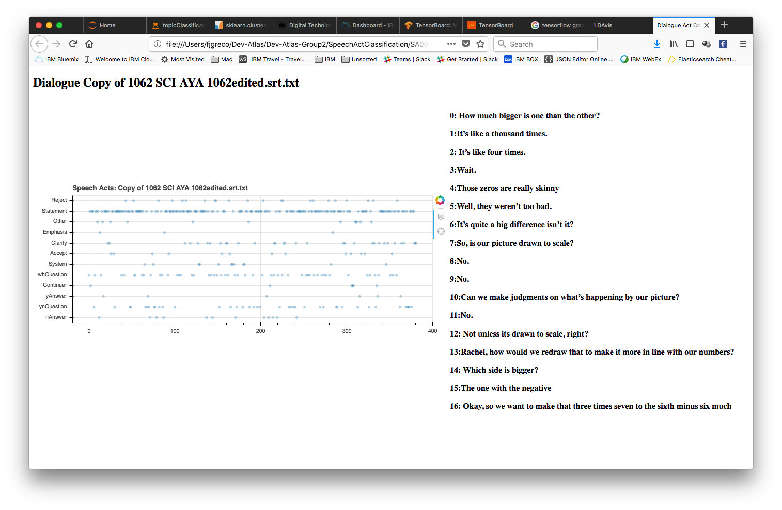
Inquiry 1 - Speech Act Identification
Figure 10
Notes:
Questions → Stanford Core NLP POS parser
Imperatives → Parse tree → Verb position & type
Declarative → Parse tree →?
Interjection → e.g. Uh-uh, Mm-mm, Okay, (NLC classifier?)
Semantic Role → if NER is the subject actor, NER not likely to be a student
1. Ran transcripts against speech predictor
based on NLTK annotated training set.
2. nltk.corpus.nps_chat.xml_posts()
3. nltk.NaiveBayesClassifier.train
For a document d and a class c, and using Bayes’ rule,
P( c | d ) = [ P( d | c ) x P( c ) ] / [ P( d ) ]The class mapping for a given document is the class which has the maximum value of the above probability.
Since all probabilities have P( d ) as their denominator, we can eliminate the denominator, and simply compare the different values of the numerator:
P( c | d ) = P( d | c ) x P( c )

Slide 48
Inquiry 1 - Speech Act Identification
Figure 10
Link to Page
Notes:
Questions → Stanford Core NLP POS parser
Imperatives → Parse tree → Verb position & type
Declarative → Parse tree →?
Interjection → e.g. Uh-uh, Mm-mm, Okay, (NLC classifier?)
Semantic Role → if NER is the subject actor, NER not likely to be a student
1. Ran transcripts against speech predictor
based on NLTK annotated training set.
2. nltk.corpus.nps_chat.xml_posts()
3. nltk.NaiveBayesClassifier.train
For a document d and a class c, and using Bayes’ rule,
P( c | d ) = [ P( d | c ) x P( c ) ] / [ P( d ) ]The class mapping for a given document is the class which has the maximum value of the above probability.
Since all probabilities have P( d ) as their denominator, we can eliminate the denominator, and simply compare the different values of the numerator:
P( c | d ) = P( d | c ) x P( c )

Slide 49
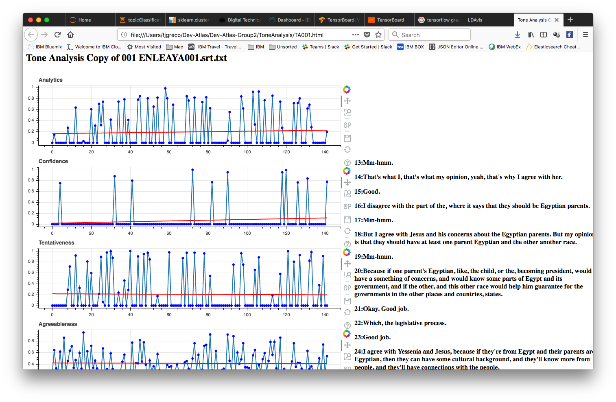
Inquiry 5 -Tone Analysis
Link to Page
Potentially useful to gauge
level of understanding
Potentially correlated with tags
Notes:
# # Measure tone or sentiment for succession of sentence/utterance frames. # # input: transcript file(s) # # output: table tone/sentiment feature list and plot for each file # #

Slide 50
Project Goal – What’s inside
Annotation
Feature Expansion
Vectorization
Classroom
Transcript
Discourse Analysis
Speech Acts
Best Practice
Adherence
Assessment
Identify Behaviors
Tag Assignment

Slide 51
Discussion
Additional Observations, Ideas, Ways to Engage....

Slide 52
Backup Slides

Slide 53
Metrics
Cosine Similarity as computed by
Compute cosine similarity between samples in X and Y.
Cosine similarity, or the cosine kernel, computes similarity as the normalized dot product of X and Y:
K(X, Y) =<X, Y>/ (||X||*||Y||)
Jaccard Distance
|(Intersection(X_{i})|/|(Union(X_{i})|
Levenshtein Distance¹
The distance is the number of deletions, insertions, or substitutions required to transform
a source string into a target string.
Precision
Recall
F
Gini importance (in decision tree modeling)
“….the (normalized) total reduction of the criterion brought by that feature .”

Slide 54
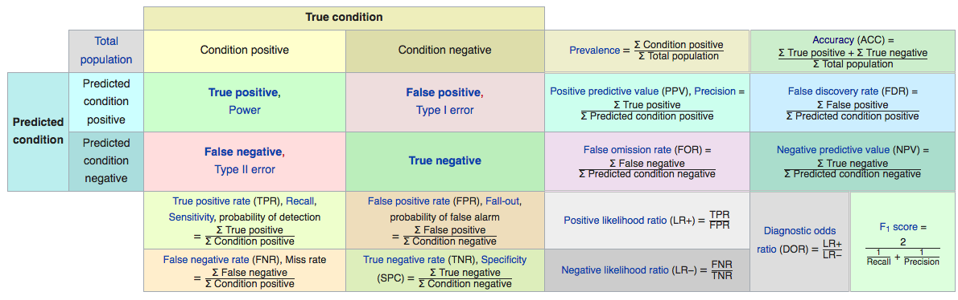
Metrics
Source: https://en.wikipedia.org/wiki/Confusion_matrix

Slide 55
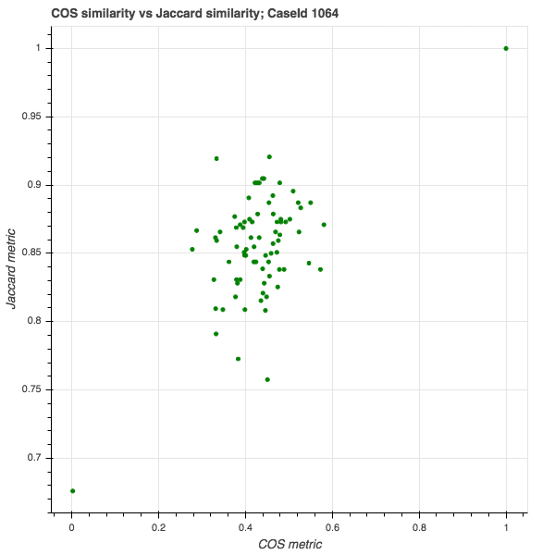
Figure 5: Similarity Check Example Closeness of Jaccard and Cosine Metrics
Notes:
TF(t) = (Number of times term t appears in a document) / (Total number of terms in the document).
IDF(t) = log_e(Total number of documents / Number of documents with term t in it).
Matrix – TF*IDF

Slide 56
Methodologies
Method |  | Tooling | Where applied
LSI |  | Gensim | G1 Similarity
COS Similarity & Jaccard Metric on TF-IDF vectors |  | Custome | G1 Similarity Test
LDA |  | Gensim (sklearn, python lda package) | G1 Topic Classification
Naïve-Bayes |  | Sklearn, NLTK | G2 Speech Acts classification
CNN |  | Tensorflow, NLC | G2 Classification
Nearest Neighbor |  | Sklearn Multiple classifiers | G2 Classification
COS Similarity on vectors |  | Sklearn | G2 classification
AdaBoost (tree optimization) |  | Sklearn | G2 Classification (ada_boost_multiclass)
"Nearest Neighbors", "Linear SVM", "RBF SVM", "Gaussian Process", "Decision Tree", "Random Forest", "Neural Net", "AdaBoost","Naive Bayes", "QDA" |  | Sklean | G2 Classification (plot classifier comparison
Decision Tree |  | Sklearn | G2 Classification (unveil tree structure)
Decision Trees, KNN, Kernel SVM, soft voting |  | sklearn | G2 Classification (voting regions)
K-Means |  | Sklearn | G2 n-gram cluster analysis
N-grams |  | Sklearn | G2 ngram cluster analysis;
POS Tagging, Tone Analysis, NER |  | StanfordNLP, NLTK,WTA, WNLU | G2 NLP Feature Extraction
N-grams |  | Sklearn | G2 OneVsRest Classification
Linear SVC |  | Sklearn | G2 OnevsRest classification
Word Embedding |  | Tensorflow/word2vec | G2 word2vec
Notes:
Cos Similarity on TF-IDF similarity ~ clustering

Slide 57
Ideas, Aspirations, and such...
CNN
Tone Analysis, Questions analysis, Topic Flow, Speech Acts,
RNN
LSTM
Widen data scope beyond transcripts

Slide 58
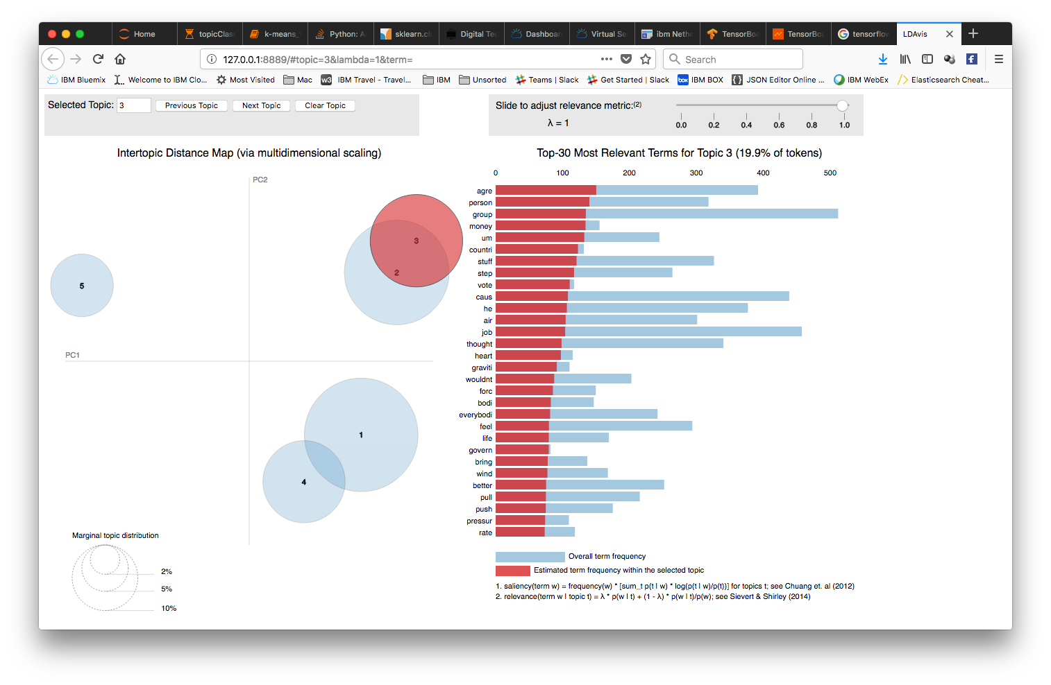
Latent Dirichlet Visualization
Notes:
Latent Dirichlet Allocation

Slide 59
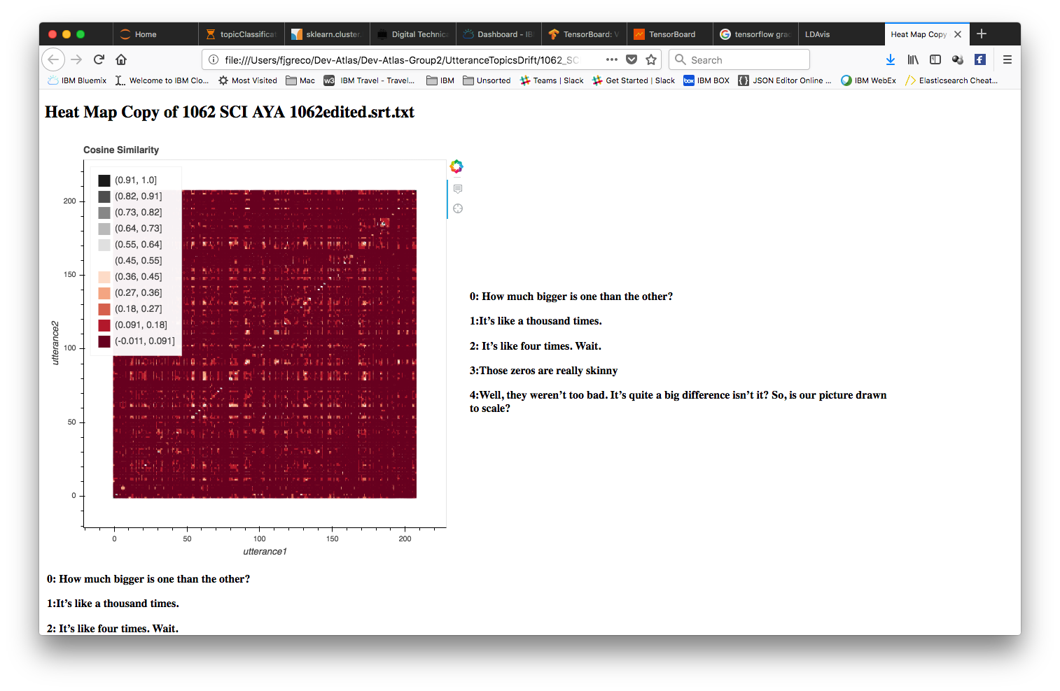
Cosine Similarity Drift Within a Transcript
Link to Page
Notes:
# # Plot heat map of cosine similarities between pairs of intra-transcript utterances. #

Slide 60
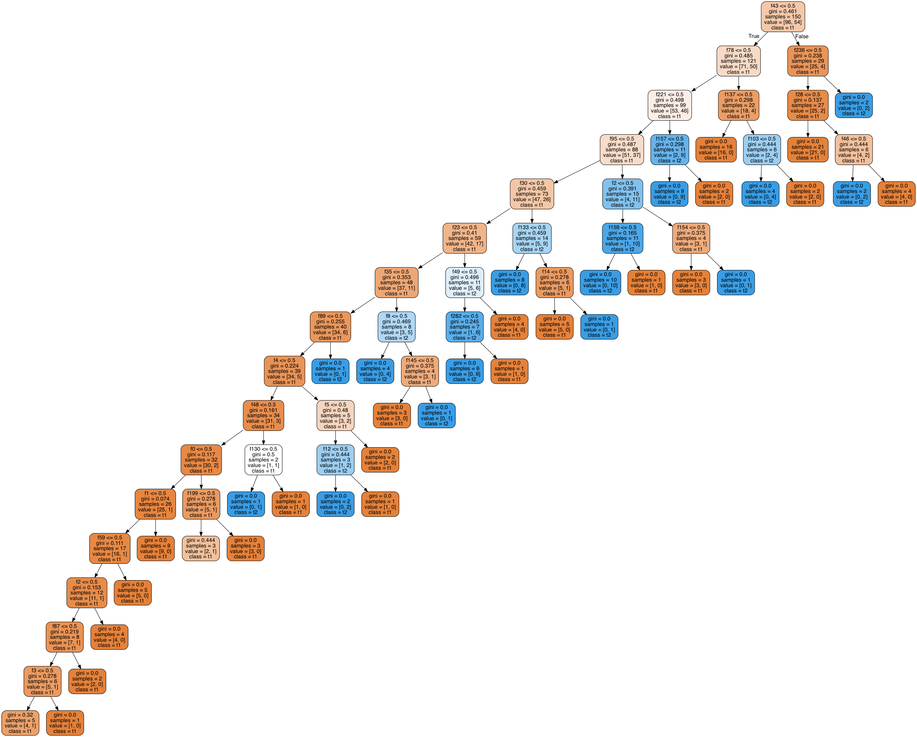
Decision Tree Based On Question Distribution Across TW08 Transcripts (Preliminary)

Slide 61
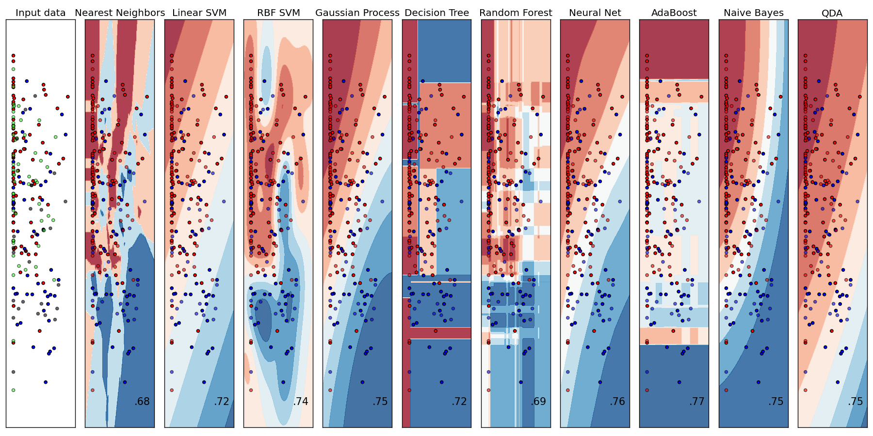
Notes:
classifier-comparison-032818
Three classifiers are initialized (`DecisionTreeClassifier`, `KNeighborsClassifier`, and `SVC`) and used to initialize a soft-voting `VotingClassifier` with weights `[2, 1, 2]`, which means that the predicted probabilities of the `DecisionTreeClassifier` and `SVC` count 5 times as much as the weights of the `KNeighborsClassifier` classifier when the averaged probability is calculated.

Slide 62
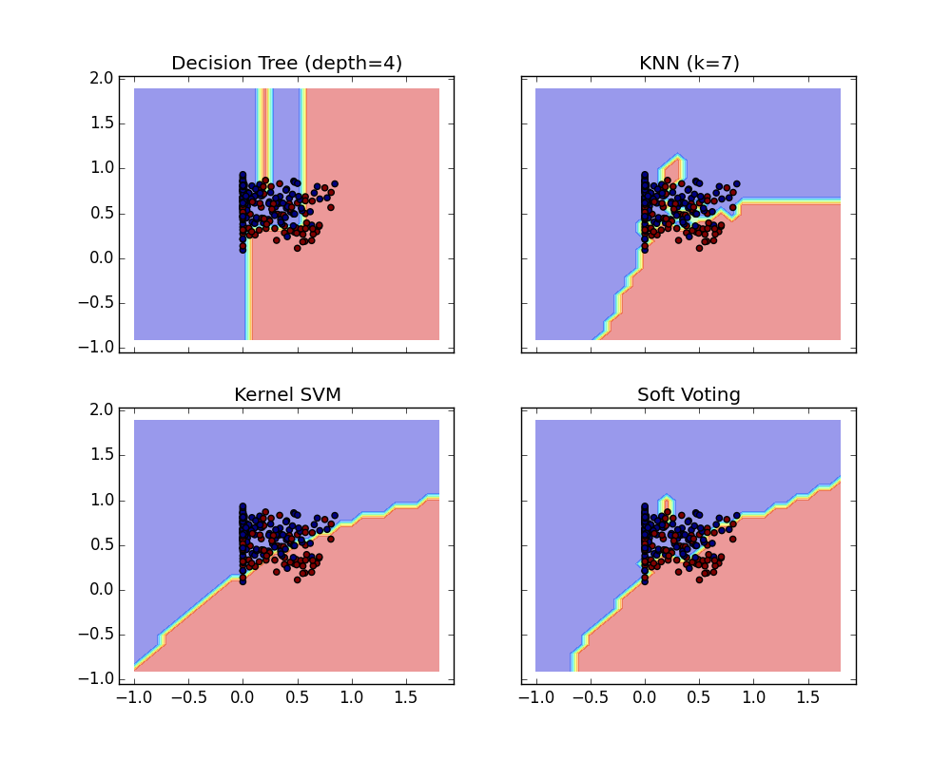
Plot Voting Decision Regions (Preliminary)
# Training classifiers clf1 = DecisionTreeClassifier(max_depth=4) clf2 = KNeighborsClassifier(n_neighbors=7) clf3 = SVC(kernel='rbf', probability=True) eclf = VotingClassifier(estimators=
[('dt', clf1),
('knn', clf2), ('svc', clf3)], voting='soft', weights=[2, 1, 2])
Run:4
DecisionTreeClassifier 0.735042735043 KNeighborsClassifier 0.683760683761
SVC 0.735042735043
VotingClassifier 0.717948717949
average score: 0.6991452991452991
average score: 0.682051282051282
average score: 0.6871794871794872
average score: 0.7059829059829059
Notes:
Three classifiers are initialized (`DecisionTreeClassifier`, `KNeighborsClassifier`, and `SVC`) and used to initialize a soft-voting `VotingClassifier` with weights `[2, 1, 2]`, which means that the predicted probabilities of the `DecisionTreeClassifier` and `SVC` count 5 times as much as the weights of the `KNeighborsClassifier` classifier when the averaged probability is calculated.

Slide 63
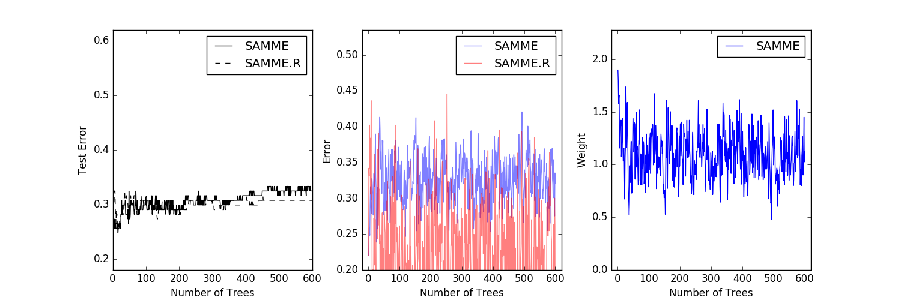
Adaboost (Preliminary)
Features: Analytic Score; Emotional Range Label: TW08 or No TW08
Notes:
This example reproduces Figure 1 of Zhu et al [1]_ and shows how boosting can improve prediction accuracy on a multi-class problem.

Slide 64
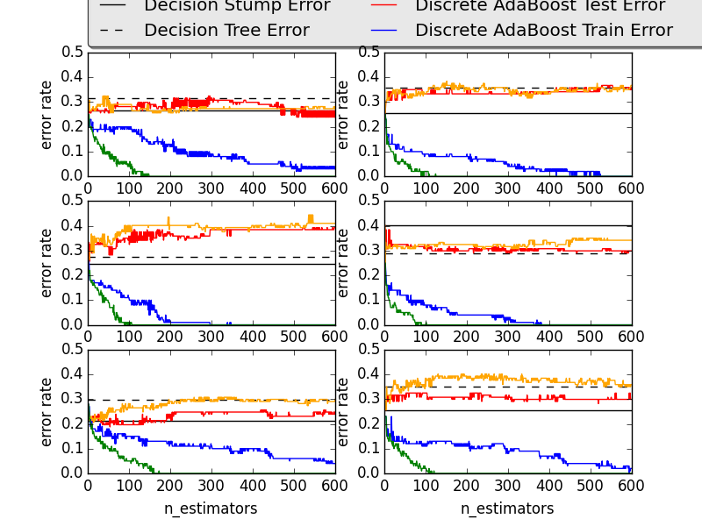
Adaboost (Preliminary)
Features: Analytic Score; Emotional Range Label: TW08 or No TW08
Notes:
This example is based on Figure 10.2 from Hastie et al 2009 [1]_ and
illustrates the difference in performance between the discrete SAMME [2]_
boosting algorithm and real SAMME.R boosting algorithm.

Slide 65
Experiment #6
Intuition: Treat dialogue chunks in as one might an image
Method: Train a (Convolutional) Neural Network treating cc segments/extents as frames
Status:
RNN/LSTM NN maybe more appropriate
Programmed a rudimentary CNN
Drawing from research on discourse analysis
Observations:

Slide 66
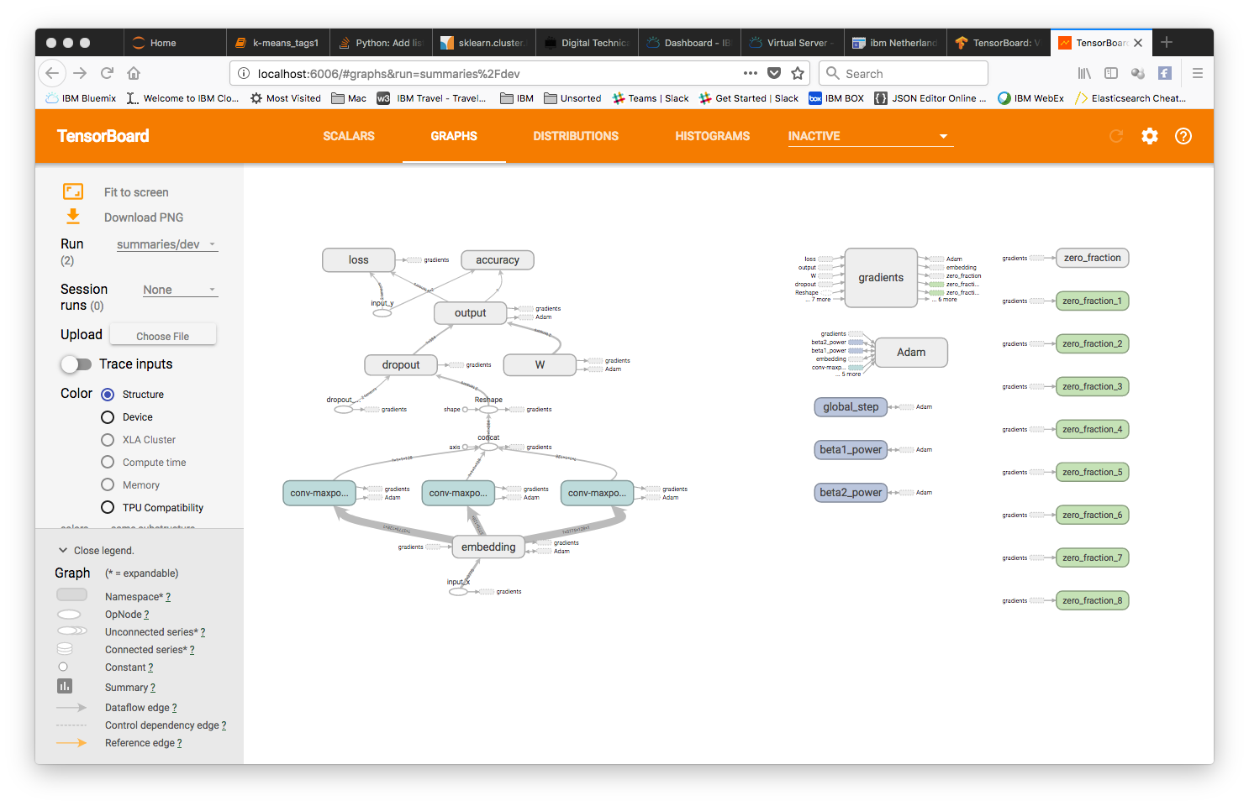
CNN - Graph

Slide 67
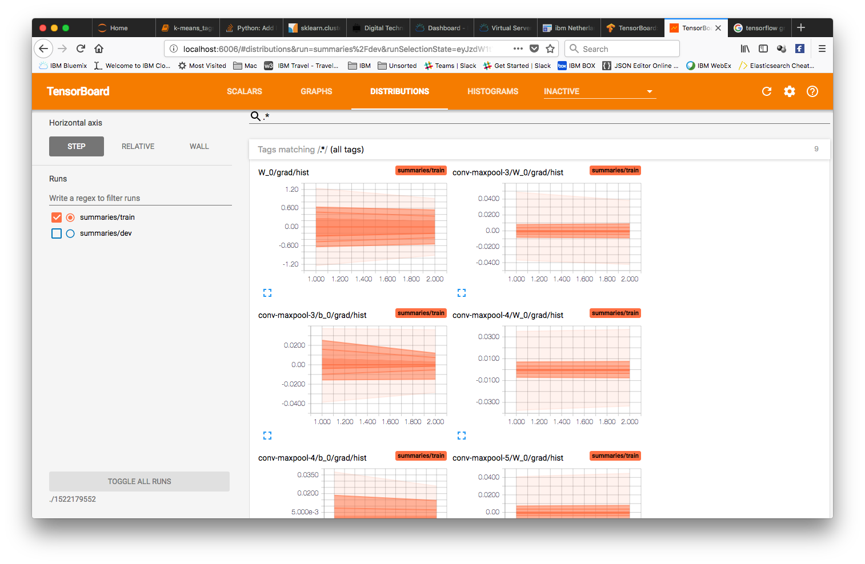
CNN-Distributions

Slide 68
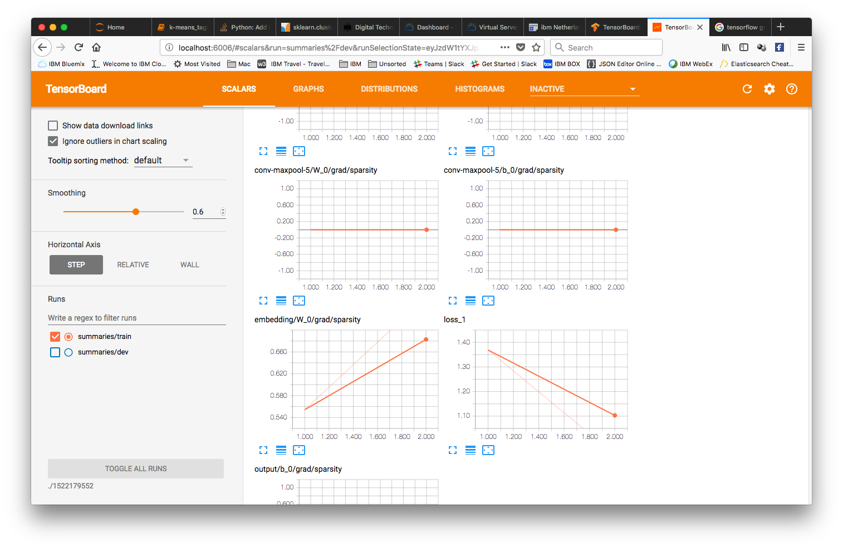
CNN-Scalars

